Slide 1
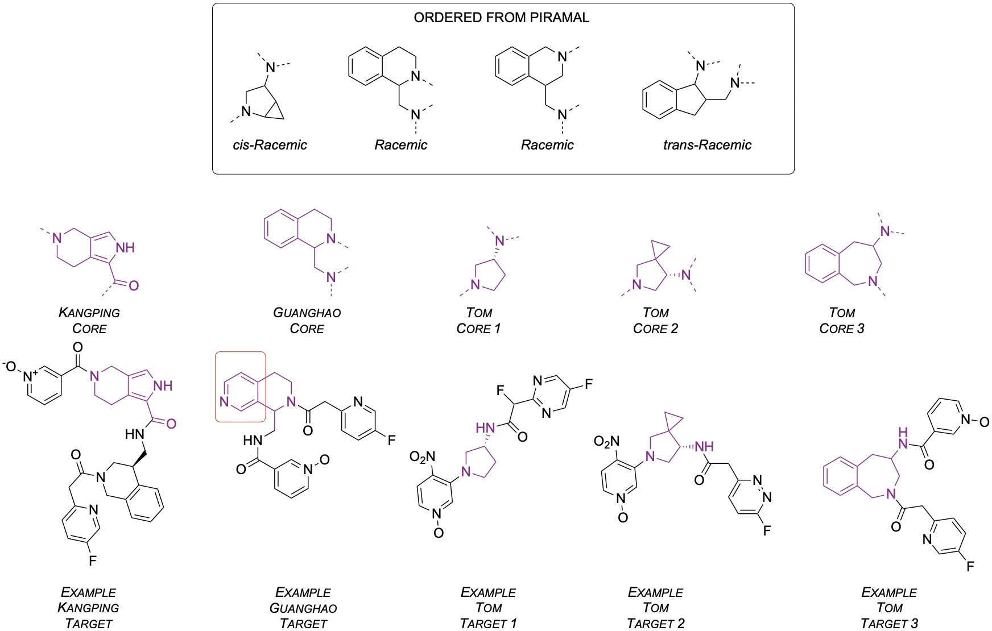
Kostya Nsp13 Predictions – Enaminable Ones, and then Some of These. Cores Non-Commercial

Slide 2
What We’d Now Like
The original core was predicted to be useful in some way: New, non-commercial, potentially useful (Enamine may want, eventually)
So let’s keep the cores, and see if different ends give molecules predicted to bind. Two ways
Iterate generative modelling, with core fixed. Same measurement/evaluation.
Enumerate library (core + all enamine carboxylic acid derivatives) and dock.
(For this project, option 1 is more interesting. But we could use the enumerated library for other targets?

